Slide 1
Embryology Digestive system – Part 2
Dr. Aso Ahmad Abdulla
Board Certified General and Laparoscopic Surgeon
FIBMS, MBChB
College of Medicine
University of Garmian

Slide 2
Midgut
from distal to liver outgrowth in duodenum to the junction of right 2/3 with left 1/3 of transverse colon
suspended with dorsal mesentery from posterior abdominal wall
communicate with a yolk sac through a vitelline duct
supplied by superior mesenteric artery and
superior mesenteric artery divide midgut into 2 parts
1- pre-artery (proximal segment): distal part of duodenum, jejunum and ileum
2- post-artery(distal segment): terminal part of ileum, caecum, appendix, ascending colon, right2/3 of transverse colon

Slide 3
Physiological umbilical hernia
It's a natural, normal phenomenon
It's the protrusion of midgut loop outside abdominal cavity through umbilical opening
From 6-12 week of intrauterine life
Abdominal cavity is small to accommodate rapid elongation of gut and increasing size of liver
Increase in abdomen size with midgut rotation accommodates midgut in the abdominal cavity

Slide 4
Rotation of gut
Midgut undergoes 270 degree counterclockwise rotation around axis passing trough superior mesenteric artery to accommodate herniated midgut loop in the small abdominal cavity.(physiological umbilical hernia)
Before rotation pre-artery located cranial to the SMA. in the middle and post-artery located caudal
rotation of midgut can be divided into 3 stage each 90(first 90 :brings back midgut loop, other 180 : occurs within abdominal cavity)

Slide 5
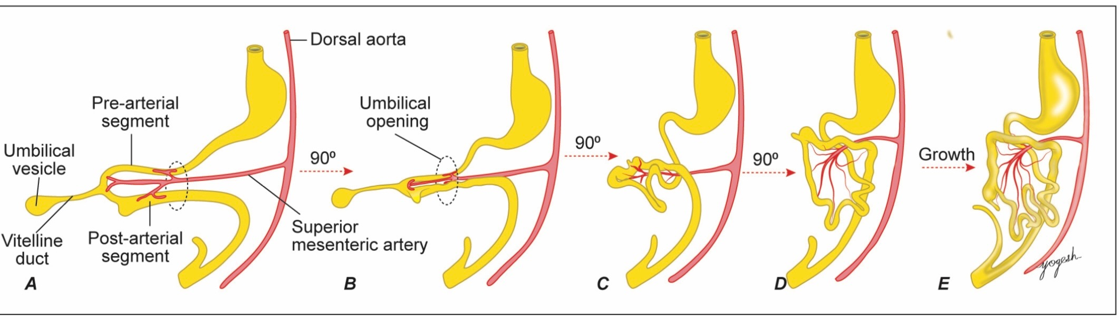
First 90 counterclockwise, this rotation brings pre-arterial segment on the right side and post-arterial segment on the left side(cecum in left side)
Second 90 counterclockwise: pre-arterial segment elongate and form coils of jejunum and ileum and come to lie behind SMA
Third 90 counterclockwise: post-arterial segment is elongate and bring cecum into right iliac fossa (adult position) and transverse colon crosses the superior mesenteric artery

Slide 6
Atresia of jejunum, ileum and colon
atresia of small intestine and colon are rare
most cases are segmental rather than localized
10% of cases involve large segment of midgut loop called apple-peel atresia, duodenum or proximal jejunum ends in blind pouch and distal small intestine wraps around SMA. and resemble apple peel
atresia is usually results from arterial occlusion rather than failure of recanalization

Slide 7
situs inversus
clockwise rotation result in
failure of rotation may result in
left sided cecum, appendix and ascending colon
incomplete rotation result in
sub hepatic caecum

Slide 8
volvulus : is rotation of intestinal loop around branch of SMA. and it may cause intestinal obstruction or even gangrene
intussusception: is the invagination of a segment of intestine in itself causing obstruction.

Slide 9
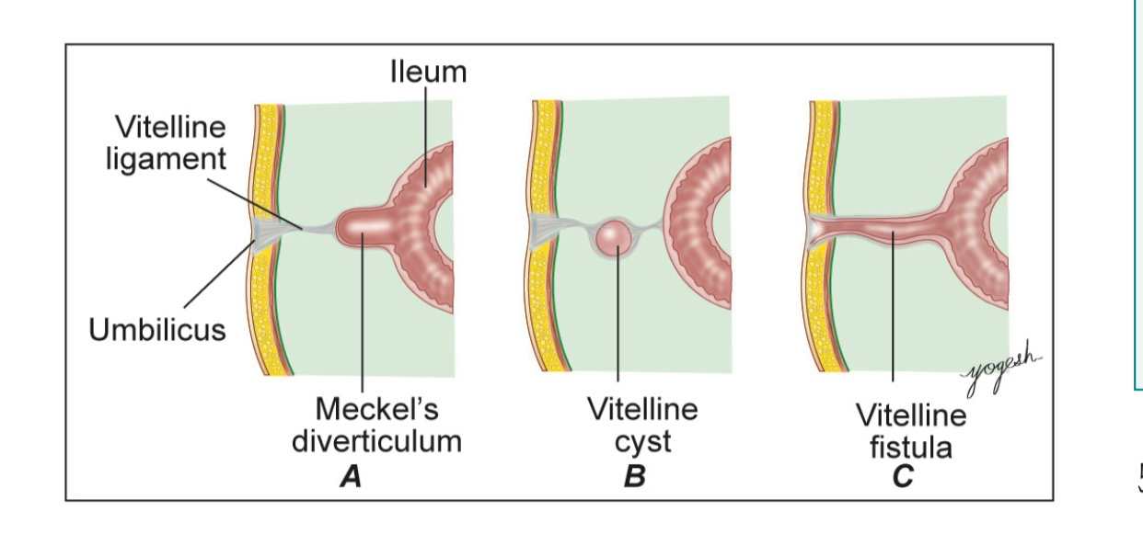
persistent vitello-intestinal duct and Meckel’s diverticulum

Slide 10
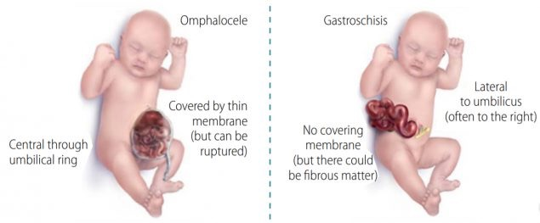
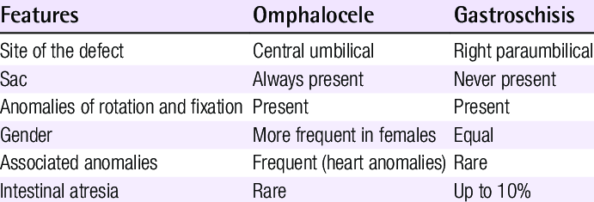

Slide 11
Hindgut
Hindgut gives rise to the following structures
Left 1/3 of transverse colon
Descending colon
Sigmoid colon
Rectum
Upper part of anal canal

Slide 12
Distal part of hindgut that communicate with allantois is cloaca
Cloaca is divided into ventral broad primitive urogenital sinus and dorsal narrow primitive rectum by growing urorectal septum
Urorectal septum also divide cloacal membrane into anterior urogenital membrane and posterior anal membrane
Cloacal membrane ruptures by 7th week
Urogenital sinus forms urinary bladder and urethra whereas primitive rectum forms rectum and upper part of anal canal
Tip of urorectal septum form perineal body
The terminal part of anal canal is ectodermal in origin because at the end of 8th week after rupture of cloacal membrane ectoderm proliferate and occlude the lower part of anal canal then recanalized and junction between end and ectoderm in anal canal called pectineal line

Slide 13
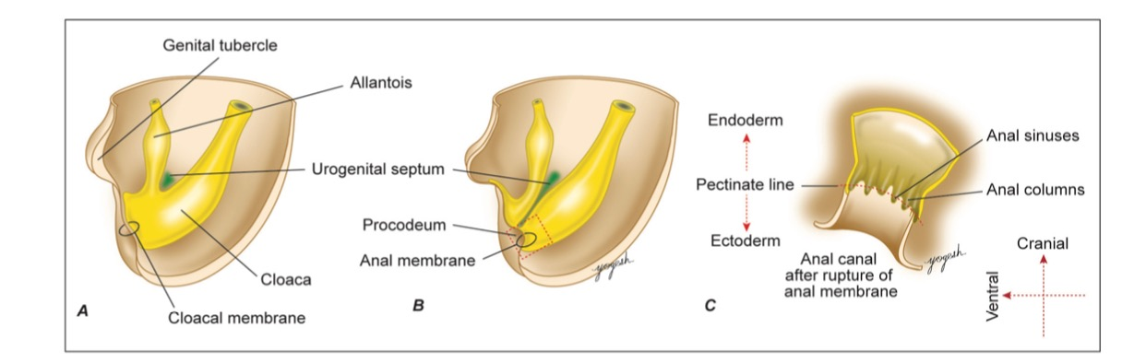

Slide 14
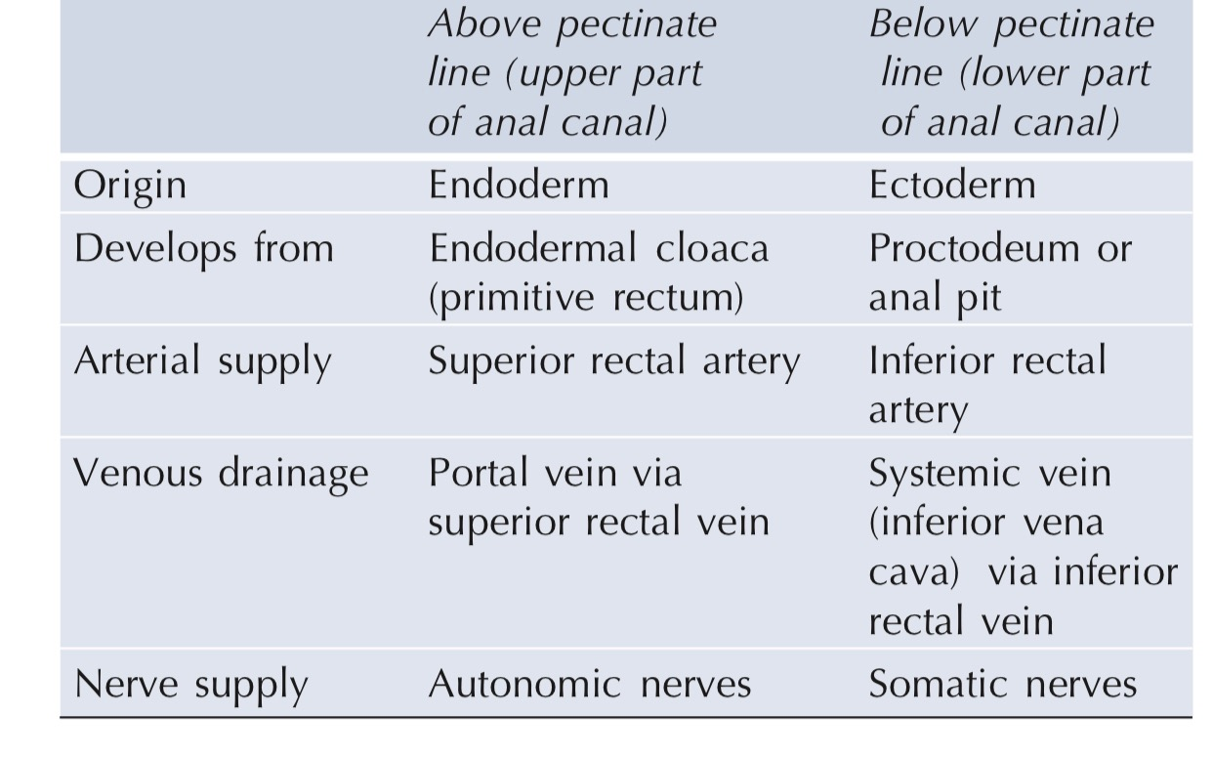
Anal canal development

Slide 15
Hirschsprung disease
Due to failure of migration of neural crest cells
A segment without parasympathetic supply ( ganglionic) show constriction and proximal to construction show dilatation due to accumulation of food
Treatment surgical resection of constricted segment

Slide 16
-failure of rupture of anal membrane
-failure of development ectodermal proctodeum
-failure of rectal development
imperforate anus
ectopic anus
abnormal division of cloacal membrane

Slide 17
Thank you

